Slide 1
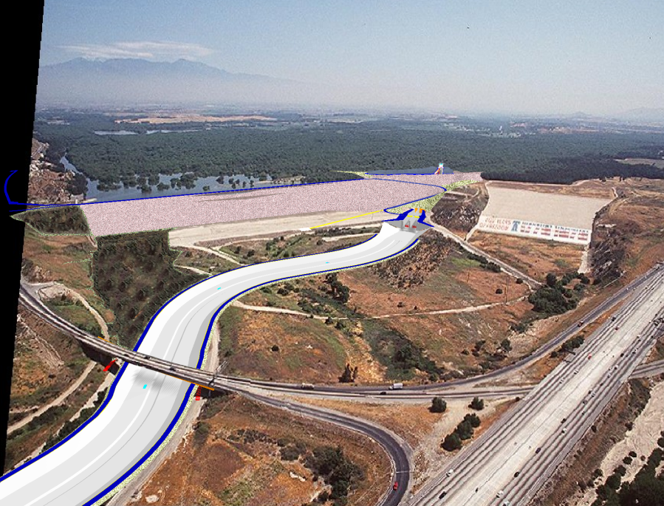
Southern California Water Dialogue
26 October 2011
Ed T. de Mesa
Chief, Plan Formulation Branch
Planning Division
Los Angeles District
US Army Corps of Engineers
Notes:
On behalf of our District Commander, Colonel Toy and the Los Angeles District, thank you for inviting me to be a part of today’s discussion.
We’re excited to be a part of the regional and local water resources solution.
We want to multiply the outputs of our flood control (flood risk) facilities to include water conservation opportunities.

Slide 2
Dam Reoperation Capabilities
Prado
San Antonio
Seven Oaks
Coyote Carbon
Fullerton
Brea
Whittier Narrows
Hansen
Lopez
Sepulveda
Santa Fe
Mojave River
Notes:
Opportunities for increased water conservation exist locally within our flood control facilities.
12 Dams candidate for multi-purpose reoperation.
Prado and Whittier are actively managed for water conservation.
Incidental water conservation for the rest – San Antonio comes close to active re-operation.
The rest have not been studied for water con potential.

Slide 3
Whittier Narrows Dam
Notes:
Here are some examples of our water conservation activities.
Whittier Narrows Dam is already being operated for flood control and water conservation.
A detailed feasibility study will begin this year to look into water conservation AND RELATED DAM SAFETY ISSUES in order to increase the conservation elevation pool from elev 201.6 ft to elev 205 ft.
Study is being conducted in partnership with LA County Public Works and the Water Replenishment District of Southern California.
At the request of our local partners, this study will consider alternatives up to elevation 205, in order to avoid impacts to existing habitat.
Water conservation pool up to elevation 205 could bring approximately 1100 acre-feet yearly of additional yield.

Slide 4
Prado Dam
Notes:
Our current operation of prado dam includes seasonal and year round water conservation.
Non-flood season up to elev 505’
Flood season up to buffer pool elev of 498’ to allow for evacuation of flood waters within 24 hours, based on weather forecast
We have a new study for prado that will begin this year as well.
At the request of Orange County Water District, the Los Angeles District has expanded one of our existing studies within Prado Basin to investigate further modification to the current operation in order to maximize watercon in tandem with their recharge facilities downstream.
This study will look at watercon and sediment issues together with opportunities for ecosystem restoration .
Alternatives would include the expansion of the buffer pool from elevation 498 feet to 505 feet during the flood season.
This could result in approximately 10,500 ac-ft of additional yield through OCWD spreading facilities.

Slide 5
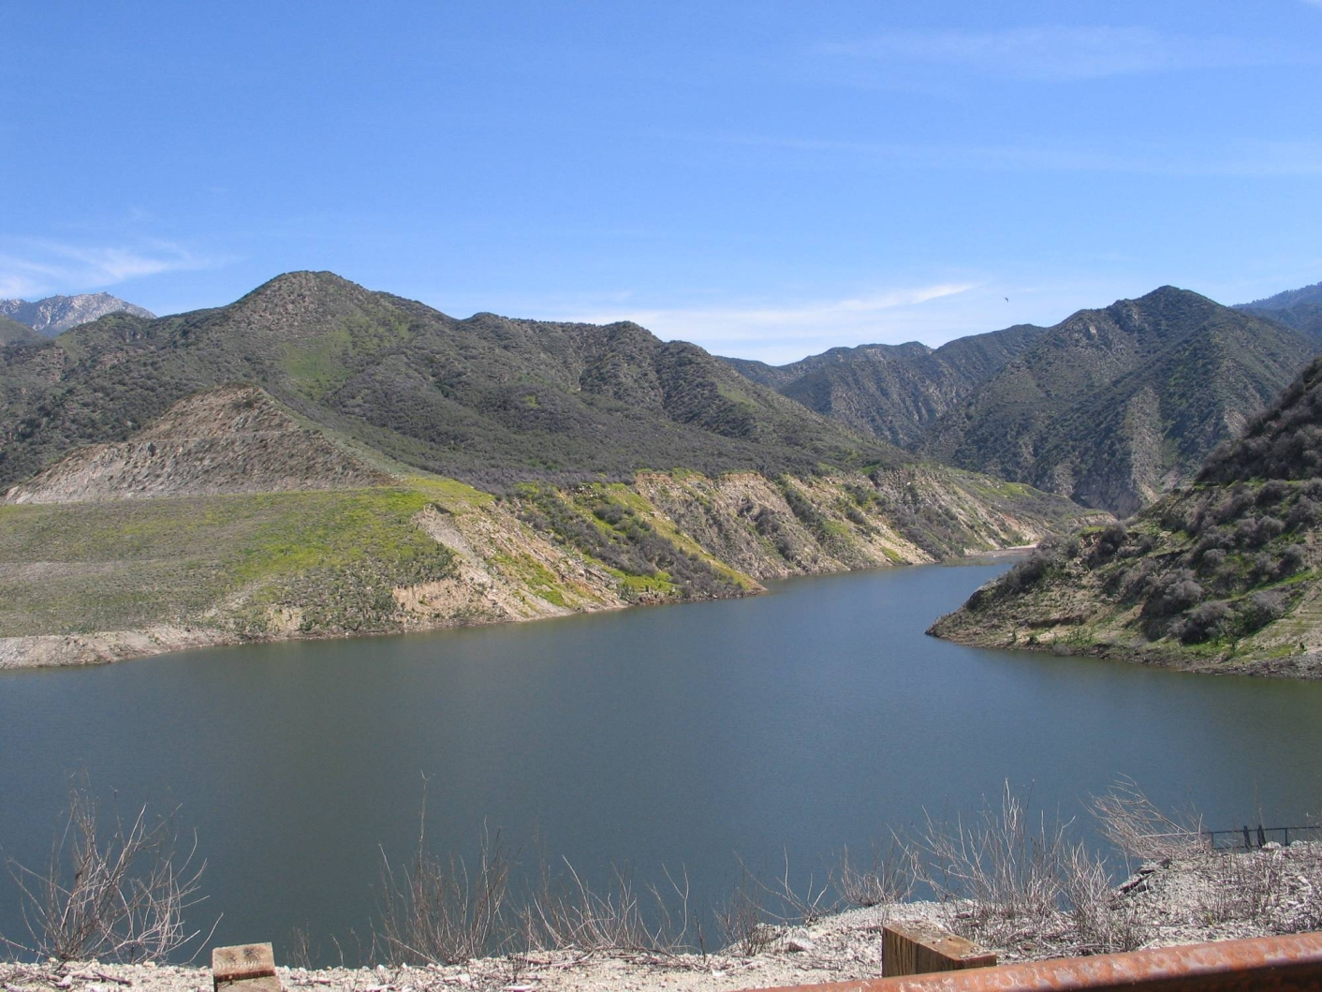
Seven Oaks Dam
Notes:
Our water con study for Seven Oaks Dam is also underway
We are conducting a review of our operations for water quality improvements as well as water conservation opportunities.
Two-Phase approach in order to expedite watercon operation.
non-flood season within the current intermediate debris pool and….
Year-round operation with higher conservation pools during flood season.
This water conservation study is cost-shared by San Bernardino County Flood Control District with support from San Bernardino Valley Municipal Water District and Western Municipal Water District.

Slide 6
Dam Reoperation Possibilities
Prado
Seven Oaks
San Antonio
Coyote Carbon
Fullerton
Brea
Whittier Narrows
Hansen
Lopez
Sepulveda
Santa Fe
Mojave River
Notes:
Other Dams within the Santa Ana River – Current incidental water conservation results in normal flood control operation of several other dams in the area. These dams are good candidates for potential re-operation to increase stormwater capture. Dams such as: San Antonio Dam, Carbon Canyon, Fullerton, and Brea. These dams present tremendous unrealized water conservation opportunity.
Carbon Canyon, Brea and Fullerton Dams in Orange County are also potential water conservation reservoirs within the Santa Ana River Watershed.
This map shows that we currently have 2 of 6 dams currently under study, the largest Corps reservoirs within the region. Increased funding levels could accelerate study completion and implementation of water conservation measures.
There is an opportunity to study the other 4 dams within the Santa Ana Watershed, but they currently lack local sponsors.

Slide 7
How Do We Do It?
Review of Completed Corps Project –review current conditions and make recommendation for corrections and improvements, which could include water conservation.
Project Authorization included a water conservation purpose or through subsequent legislation.
Water Supply Act of 1958, allows the Chief of Engineers to conduct studies to add water supply as additional purpose to completed projects.
Notes:
Corps Authorities to conduct Re-operation studies and implement dual-purpose re-operation.
Review of Completed Corps Project – inherent in the project authorization of our flood control facilities is the ability of the Corps to review current conditions and make recommendation for corrections and improvements, which could include water conservation.
Project Authorization included a water conservation purpose or through subsequent legislation.
Water Supply Act of 1958, allows the Chief of Engineers to conduct studies to add water supply as additional purpose to completed projects.
All these authorities could apply to local flood control and allow the District to conduct a water conservation study provided that a local COST-SHARING non-Federal sponsor is interested and willing to conduct these studies.
The Los Angeles District is always readyto work with you and pursue the necessary studies to re-operate our dams for other uses particularly – WATER CONSERVATION!

Slide 8
How Do We Get Started?
Conduct a cost-shared feasibility study with non-Federal sponsors
Letter of Interest addressed to COL Toy and the Los Angeles District would initiate the budgetary process
Collectively pursue study funds
Implementation and operation costs are 100% Non-Federal responsibility
Notes:
As you are aware, Corps does not have the authority to conduct studies and project related to Water Conservation and water supply unless authorized and funded by Congress.
Fortunately, we already have the authorities to conduct the studies ..we just need the funds and a non-Federal partner get started.
READ SLIDE
All these authorities could apply to local flood control and allow the District to conduct a water conservation study provided that a local COST-SHARING non-Federal sponsor is interested and willing to conduct these studies.
In the west, compared to elsewhere in the country RE-OPERATION VS RE ALLOCATION TRANLATES INTO REDUCED COSTS.
The Los Angeles District is always ready to work with you and pursue the necessary studies to re-operate our dams for other uses particularly – WATER CONSERVATION!

Slide 9
Thank You!
Contact Information
Ed T. de Mesa
Chief, Plan Formulation Branch
Planning Division
Los Angeles District
US Army Corps of Engineers
Tel : 213-452-3820
Notes:
To close, on behalf of Colonel Toy, I appreciate this opportunity to address the group.
We are looking forward to assist in getting all of us closer to this water conservation goal.
Should you have any questions, my contact information is here.
You can always contact me for study ideas you might have.
THANK YOU!!

Slide 10
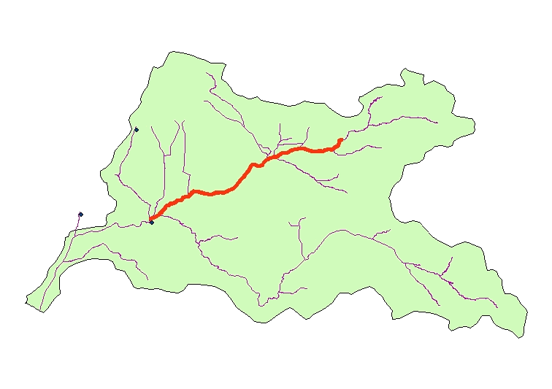
Corps Dams: Water Conservation Opportunities In the Region
San Antonio
Carbon Canyon
Fullerton
Brea
7 Oaks
Santa Ana River Watershed
Prado
Under Study – Under-funded
No Study/Sponsor/Funding
Notes:
Other Dams within the Santa Ana River – Current incidental water conservation results in normal flood control operation of several other dams in the area. These dams are good candidates for potential re-operation to increase stormwater capture. Dams such as: San Antonio Dam, Carbon Canyon, Fullerton, and Brea. These dams present tremendous unrealized water conservation opportunity.
Carbon Canyon, Brea and Fullerton Dams in Orange County are also potential water conservation reservoirs within the Santa Ana River Watershed.
This map shows that we currently have 2 of 6 dams currently under study, the largest Corps reservoirs within the region. Increased funding levels could accelerate study completion and implementation of water conservation measures.
There is an opportunity to study the other 4 dams within the Santa Ana Watershed, but they currently lack local sponsors.

